Slide 1



Identifying Human Challenges
In an increasingly complex and fast-paced world, people face a variety of problems that impact their daily lives, productivity, and overall well-being. Understanding and addressing these challenges is crucial for enhancing the human experience and driving progress.
Ca
by Cj Agustin

Slide 2

The problem: Inefficient Energy Usage
Limited Resources
Environmental Damage
Fossil fuels and other traditional energy sources are finite and becoming increasingly scarce, leading to concerns about long-term sustainability.
The extraction and use of non-renewable energy sources contribute to pollution, greenhouse gas emissions, and environmental degradation.
Rising Costs
As demand for energy increases, the costs of energy for both individuals and businesses are rising, creating financial burdens.

Slide 3
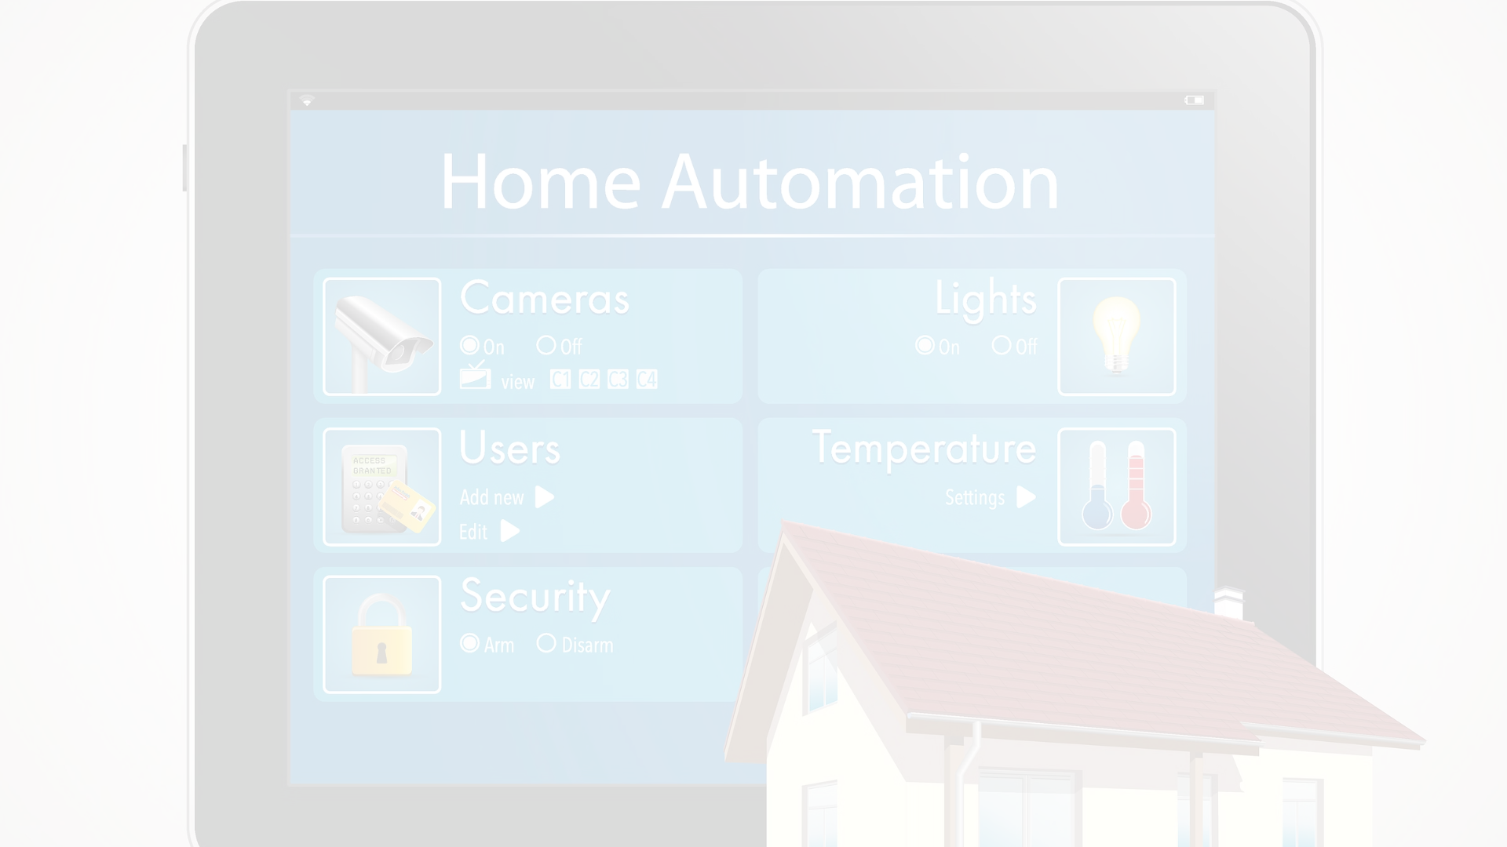
The technological solution
The proposed technological solution is a smart home automation system that can intelligently monitor and control home environments.
This system utilizes a network of internet-connected sensors and actuators throughout the home to gather data and automate various home functions.
By leveraging machine learning algorithms, the system can learn user preferences and optimize energy usage, home security, and other key functions.

Slide 4

How the Solution Works
The proposed technology leverages advanced algorithms and sensors to continuously monitor the problem area. By collecting real-time data, the system can quickly identify patterns and anomalies, allowing for rapid intervention and problem resolution.
Through machine learning and predictive analytics, the technology anticipates future issues before they arise, enabling proactive solutions that address the root causes of the problem.

Slide 5
Potential benefits
1
Improved Productivity
2
Cost Savings
The solution can help automate repetitive tasks, freeing up time for employees to focus on more strategic work.
By streamlining processes and reducing manual errors, the solution can lead to significant cost savings for the organization.
3
Enhanced User Experience
4
Competitive Advantage
The intuitive interface and seamless integration can provide a more enjoyable and efficient experience for customers or end-users.
Early adoption of the innovative solution can give the organization a strategic edge over competitors in the market.

Slide 6
Potential drawbacks
Privacy Concerns
Accessibility Challenges
Ethical Considerations
Cost Barriers
Implementing the technological solution may be costly, which could limit its widespread adoption and accessibility. Efforts should be made to keep the solution affordable for individuals and organizations.
The technological solution may raise privacy concerns if it requires collecting or accessing sensitive personal data. Proper data protection measures must be implemented to ensure user privacy.
The solution should be designed with accessibility in mind to ensure it can be used by people with disabilities. Failure to do so could exclude certain groups from benefiting from the technology.
There may be ethical dilemmas to address, such as the potential for the technology to be used for surveillance or manipulation. Safeguards should be put in place to prevent misuse.

Slide 7




Implementation considerations
Technical infrastructure
User training
Regulatory compliance
Develop comprehensive training programs to educate end-users on how to effectively utilize the new technology.
Carefully review and address any legal or regulatory requirements that may impact the implementation of the solution.
Ensure the necessary hardware, software, and connectivity are in place to support the technological solution.

Slide 8
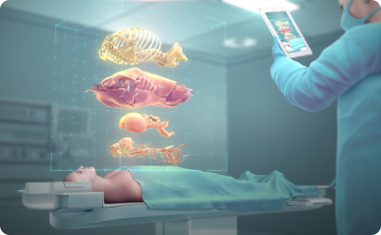
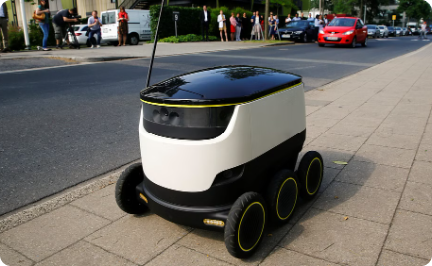
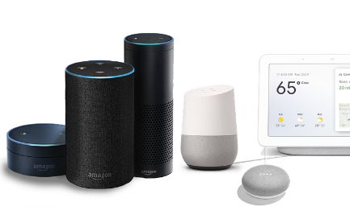
Real-world examples
Augmented Reality in Healthcare
Autonomous Delivery Robots
Voice Assistants in Smart Homes
Hospitals are using AR to project 3D models of organs, helping surgeons visualize complex procedures and plan treatments more effectively.
E-commerce companies are deploying self-driving robots to transport packages the "last mile" to customers, improving efficiency and reducing delivery times.
Intelligent voice-controlled systems are enabling homeowners to effortlessly manage lighting, temperature, security, and other home functions through simple voice commands.

Slide 9

Future Developments
1
Enhanced Capabilities
As the technology advances, we can expect even more sophisticated capabilities, such as improved accuracy, faster processing, and expanded functionality.
2
Increased Accessibility
Future developments may make the solution more accessible and affordable, allowing a wider range of people to benefit from its capabilities.
3
Integration with Other Technologies
The solution could be seamlessly integrated with other emerging technologies, enabling new and innovative applications that enhance our daily lives.

Slide 10

Conclusion
In conclusion, the proposed technological solution offers a promising approach to addressing the human problem of [Describe the human problem or challenge]. By [Explain how the technological solution addresses the problem], this solution has the potential to [Discuss the potential positive outcomes or impact of the solution]. While there are some [Discuss any potential negative outcomes or challenges] to consider, with thoughtful [Discuss factors to consider when implementing the solution], this technology could be effectively implemented and lead to real-world applications. As this field continues to evolve, we can expect .By understanding the complexities and nuances of these challenges, we can develop targeted solutions that improve quality of life, promote well-being, and foster resilience in individuals and communities alike. Through ongoing research, dialogue, and collaboration, we can continue to identify and confront these challenges, ultimately striving towards a more equitable and sustainable future for all.

Slide 11
Human Problem/Challenge: Difficulty in Accessing Healthcare Services in Rural Areas
Technological Solution: Telemedicine Platforms and Mobile Health (mHealth) Apps

Slide 12
Potential Outcome/Impact:
Implementing telemedicine platforms and mHealth apps can significantly improve access to healthcare services in rural areas. Patients can consult with healthcare professionals remotely, reducing the need for travel and overcoming geographical barriers. This technological solution can lead to several positive outcomes:

Slide 13
Increased Access: Telemedicine enables individuals in remote or underserved areas to connect with healthcare providers without the need to travel long distances, thereby improving access to medical expertise and reducing healthcare disparities.

Slide 14
Cost Savings: Telemedicine can reduce healthcare costs for both patients and providers. Patients save money on transportation and related expenses, while healthcare facilities can streamline operations and reduce overhead costs associated with maintaining physical infrastructure.

Slide 15
Timely Intervention: With telemedicine, patients can receive timely medical advice and intervention, potentially preventing health conditions from worsening and leading to better health outcomes.

Slide 16
Continuity of Care: Telemedicine facilitates ongoing communication between patients and healthcare providers, ensuring continuity of care even for individuals living in remote areas. This can lead to improved management of chronic conditions and better overall health management.

Slide 17
Health Education and Prevention: mHealth apps can deliver health education resources and preventive care reminders to individuals in rural areas, empowering them to take proactive steps towards maintaining their health and preventing diseases.

